Slide 1

THE GLOBAL MARKET WANTS YOU TO BE AGILE
Author:
Alexandre
Simundi
Notes:
“The Global Market Wants You to be Agile”.
Following the new vision and the ambitious plans for V1, I liked the agile methodologies practices with that global vision.
I take very seriously when some one ask me to thing/talk/show something about methodologies. During the past few years I’ve seen many terrible things about software projects. Companies wasting lost of money and 2 years of 70 people work being throwing away.
What I’m going to show here isn’t that agile is solution for all the problems, but it can help much more on this journey, than older approaches. Actually, it’s a evolution of them.

Slide 2

1 million’s question:
Why would someone spend money in software?
Notes:
The company has a budget of 1 million and will spend that in software, why would they do that? What are they looking for?

Slide 3
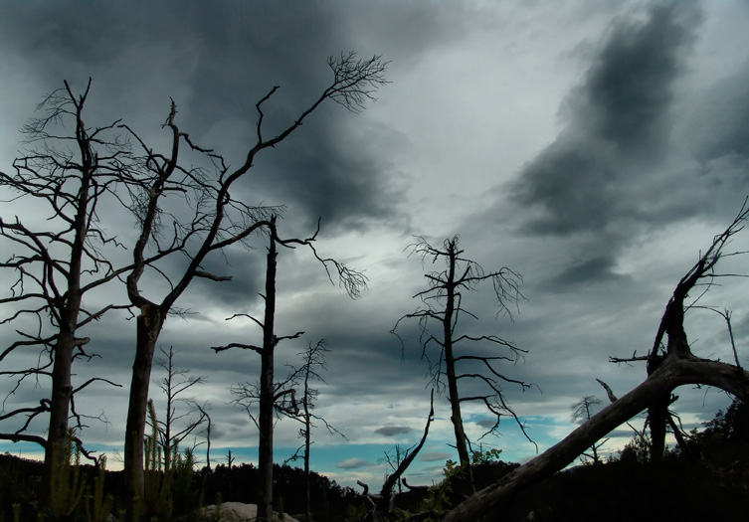

TRANSFORMATION
Better Scenario
(solutions)
Current Scenario
(problems)
Reduce 40% the operation cost
Sell 40% more in 20XX
Increase 30% the usage of the product
Achieve 3.000 unique access per day
Notes:
Any software project is part of a bigger strategy, as consultant, our duty is drive the customer transformation to achieve the strategy beyond the software.
We must understand the what’s causing the problems and avoiding the transformation happen, then ATTACK THEM. Not necessarily creating software. Changing process, behaviors and mindsets some times are part of this transformation.

Slide 4
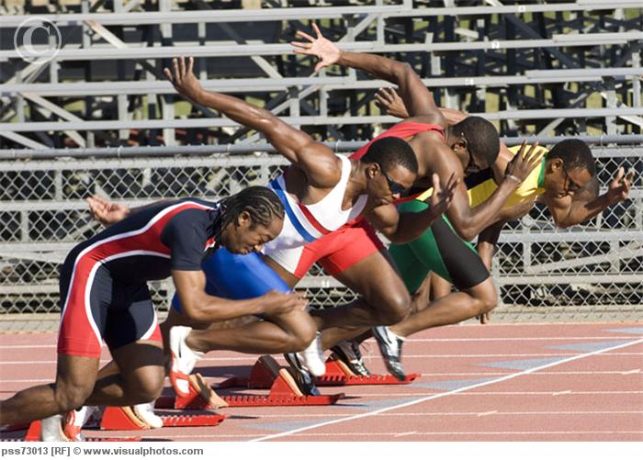
Easy, let’s start!!

Slide 5

What can I do for you?
I want a login screen and a small client’s CRUD
Notes:
We send a experienced system analyst to the customer, to collect the requirements, define the scope of the project, estimate it.
We go to the customer to hear the he is expecting from the solution and we do it.
From this point, the only thing which matter is keep the costs and don’t loose money! (WHAT ABOUT THE TRANSFORMATION?)

Slide 6

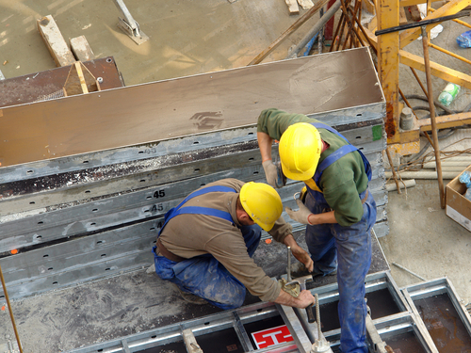
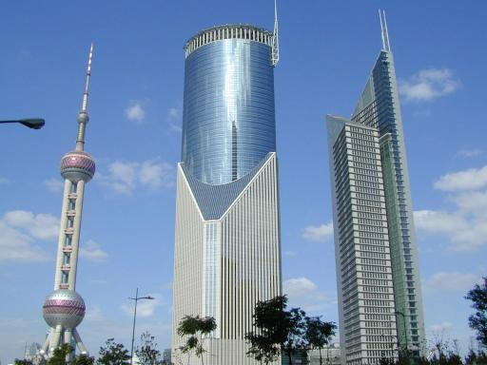
Design, Build, Live
Notes:
Then we start build and start delivery packages incrementally.

Slide 7
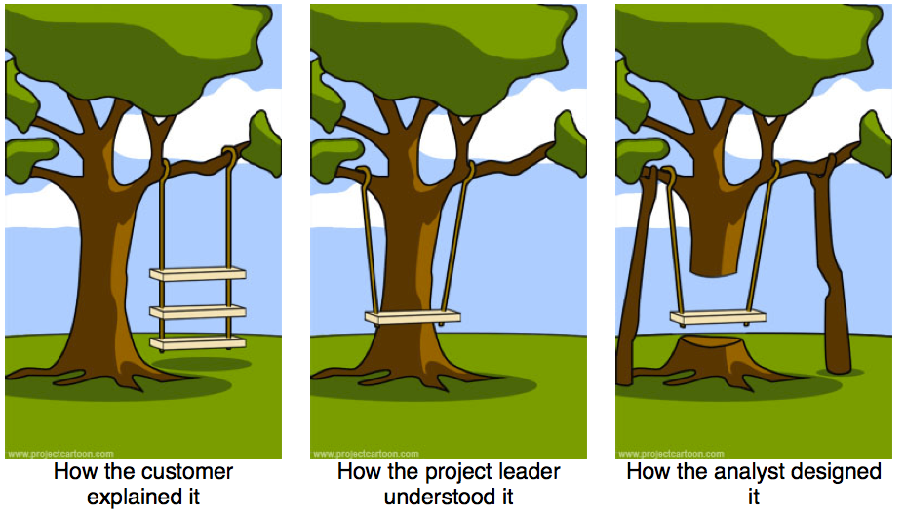
Result
Notes:
Classic software development history.. Don’t need much explanation…

Slide 8
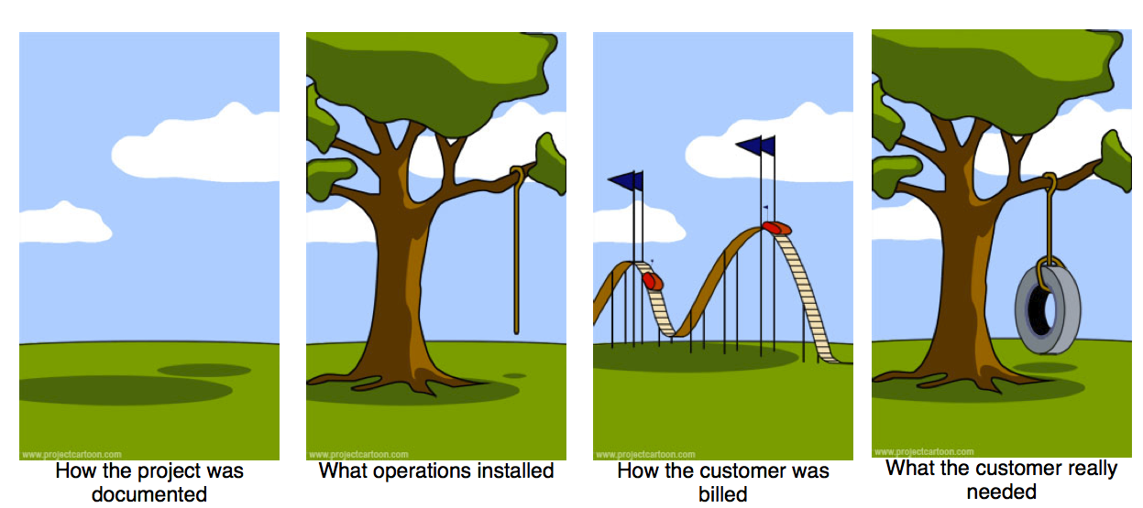
Result

Slide 9
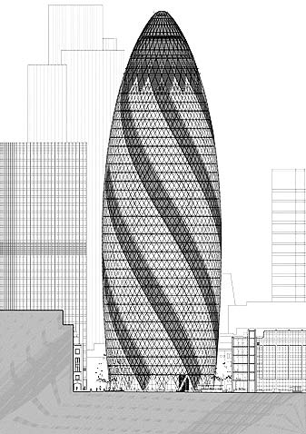
We build software!
Notes:
We build software!!!! And software has it’s own nature. There wasn’t nothing like that in the world, so be careful in base your methodology on others like civil construction, cars manufacturing.
Why is it different? Because you can’t see it! Even when you can see it, you can’t test it! Even when you can test it you don’t have sure what behavior you will get from the users.

Slide 10

Can they see it?
Notes:
When you are building a house, you can see the material going out. You can see the walls being built and all.
If customer walk through the Version 1’s office, what would they see? Can he see the where the money is going to?

Slide 11

Can they test it?
Notes:
Can The customer’s user use the product, which he has already expended money on, and try it?

Slide 12
TRANSFORMATION
?
Notes:
And what about the Transformation points that we said before?!
How or When can we check if it was achieved or not? (How and When?? Time to think about it)

Slide 13
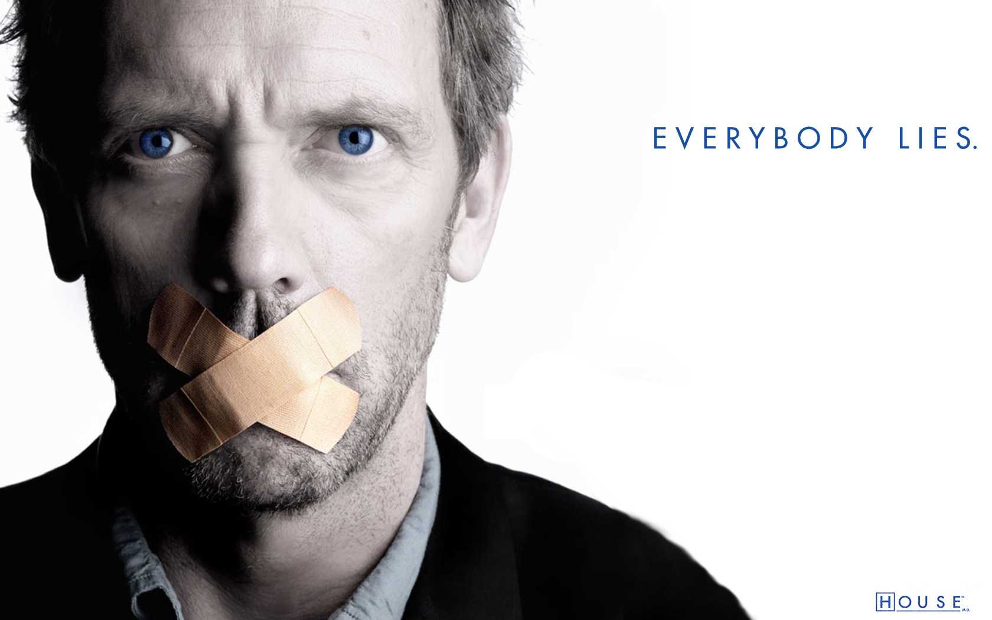
UNTIL PRODUCTION TIME
Notes:
Documentation lies
Architecture lies
Requirements lies
The propose solution lies

Slide 14
“Predictability is a very desirable property. However if you believe you can be predictable when you can't, it leads to situations where people build a plan early on, then don't properly handle the situation where the plan falls apart.”
Martin Fowler

Slide 15
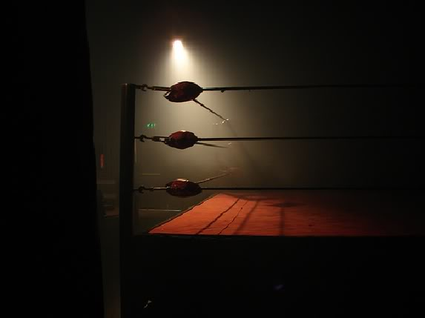
Predictive vs Adaptative
Notes:
The old methodologies, plan-driven based, starts from the idea that requirements are 80% predicable. But predicable isn’t a property for creative process.
Predictive methodology: Scope, Time, Price should be defined.
Adaptive methodology: Goals and Price are defined.
“So what we see here are two fundamentally different activities. Design which is difficult to predict and requires expensive and creative people, and construction which is easier to predict. Once we have the design, we can plan the construction. Once we have the plan for the construction, we can then deal with construction in a much more predictable way. In civil engineering construction is much bigger in both cost and time than design and planning.” Martin fowler
“Can you get a design that is capable of turning the coding into a predictable construction activity? And if so, is cost of doing this sufficiently small to make this approach worthwhile?” Martin fowler
Civil engineer: design 10% of the cost, build the rest
Software: Design: design 50% of the cost, build 15%
“This thinking leads to some important conclusions:
In software: construction is so cheap as to be free
In software all the effort is design, and thus requires creative and talented people
Creative processes are not easily planned, and so predictability may well be an impossible target.
We should be very wary of the traditional engineering metaphor for building software. It's a different kind of activity and requires a different process”
Martin Fowler

Slide 16
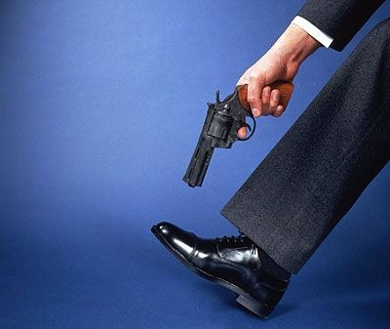
Software’s Cancer
Closed scope
Big design up to front
Focus on signed-off documentation
Control what we shouldn’t
Waste of resources (financial and personal)

Slide 17
Be intrinsic in the customer’s DNA means work end-to-end on their business and drive the change.
Notes:
When I saw the new vision in the V1 company’ briefing I thought, hell that’s what agile means. Also, that is what waterfall DOESN’T mean.

Slide 18
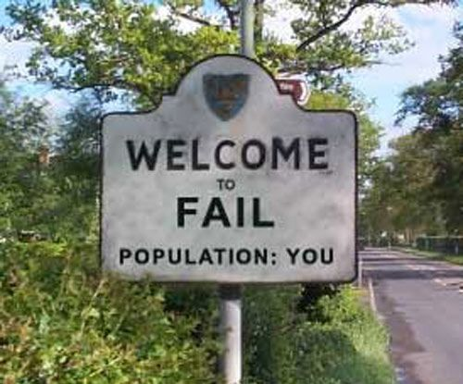
WATERFALL
Notes:
In a project point of view, fail will be consider: out of the budget (consume more man/hours), delivered lately and don't meet the customer’s needs.
And beyond of the project scope, if we’re thinking about Waterfall, we are going against our vision.

Slide 19
TRANSFORMATION
DRIVE
Notes:
That’s is be intrinsic in customer’s DNA

Slide 20
AGILE
Notes:
Now is time to understand where agile acts.

Slide 21

MINDSET CHANGE

Slide 22

DISCOVERING PROCESS
Notes:
Software Development is not a “taking order” process. It’s a process that you know where do you want to get and hypothesis ideas of how get there, and you have to prove if this ideas are right.
The customer’s will discover what is the best possible solution.
Team will discovery how deal with the customer’s business. How they decisions are making and what the software should contain in order to fulfill the customer’s business.

Slide 23

VALUE DELIVERY
Notes:
Value delivery is a constant. Every feature delivered must achieve a goal. If the business can’t explain the importance of a task, the team will say NO!
If the customer doesn’t know how that feature, architecture component, etc will help him earn money WE WILL SAY NO! “Say no” means don’t wast money in features based on expectations, but invest money in FACTS.

Slide 24

BASED ON FEEDBACK
Notes:
Tha’t show

Slide 25
CONTINUOUS
Team
Feedback
Business
Feedback
Market
Feedback

Slide 26
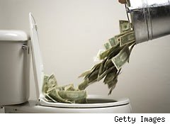
REDUCE WASTE
Notes:
Reduce waste means eliminate(or reduce) any activity which doesn’t contribute directly to final product.
Reduce waste one
Waste #1 - Partially Done Work
Waste #2 - Extra Features
Waste #3 - Relearning
Waste #4 - Handoffs
Waste #5 - Delays
Waste #6 - Task Switching
Waste #7 - Defects

Slide 27

FOCUS ON QUALITY
Notes:
Unlike some people believe, agile has focus on quality!
Focus on quality means have QA from the beginning.
QA beside of any activity or delivered artifact
It means that learn from the mistakes
It means any quality issue should be investigated in order to figure out the cause

Slide 28

PEOPLE FIRST
Notes:
People first means believe that everyone in the team has something to add
Everyone is capable to contribute and improve the process, product and business.
Also, any process must consider that each project has different people, with different knowledge, minds, opinions and different ways to work efficiently. And the process, the leader, methodology must be able to extract the best from the team.

Slide 29
Based on Principles!
Individuals and interactions over processes and tools
Working software over comprehensive documentation
Customer collaboration over contract negotiation
Responding to change over following a plan
That is, while there is value in the items on the right, we value the items on the left more.
Notes:
Now they should understand what those principles mean.

Slide 30

how?!

Slide 31
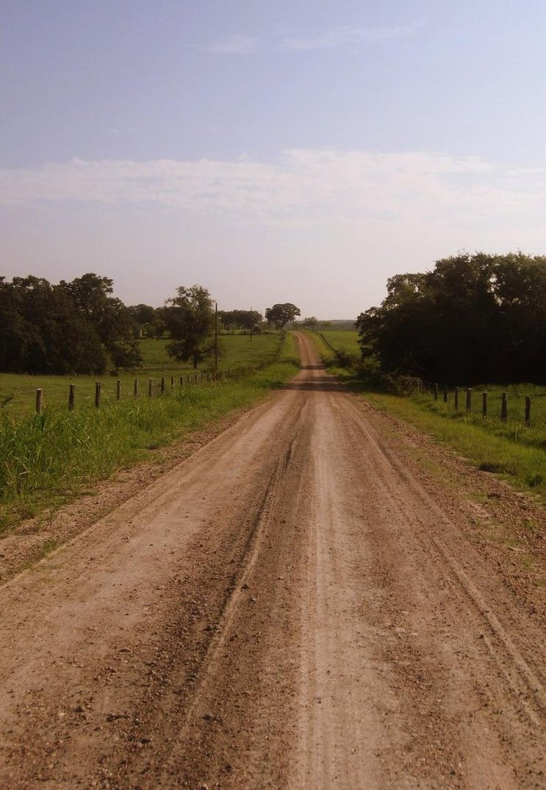
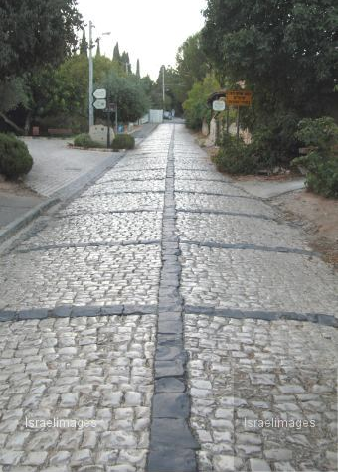

INCREMENTALY
Notes:
That’s normally the biggest misunderstanding about agile approach. Incrementally doesn’t mean delivery one module/screen per time. It means that we are focus on what is surely needed right now. And leave what is uncertain for later.

Slide 32
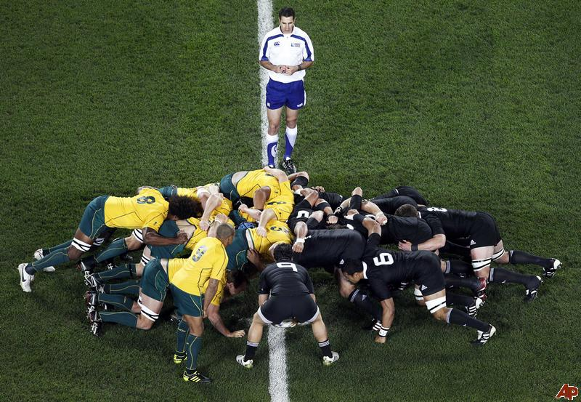
COLABORATION
Notes:
No departments!!!!! There is one time and one goal. (BUSINESS + DEV + QA + PM + OPS + whatever)

Slide 33
FEEDBACK ROUNDS
Business
ASAP
Market
ASAP
Team
Daily

Slide 34
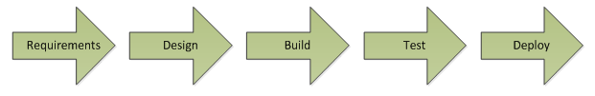
CONTINUOUS DELIVERY
2 weeks
Iteration 0 | Iteration 1 | …. | Iteration 6 | … | Iteration 10 | …
PRODUCTION
PRODUCTION
Notes:
Requirements + Design + Construction happen together, in small steps, avoiding to make decisions without enough information or, even worst, based on the wrong assumptions.

Slide 35
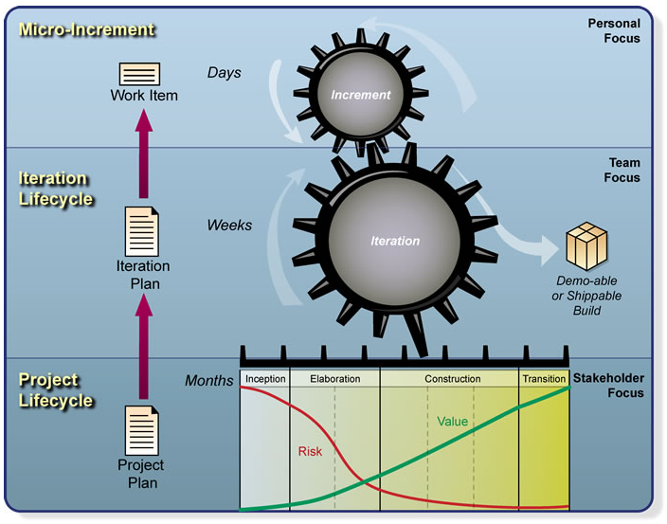
Notes:
Scrum

Slide 36
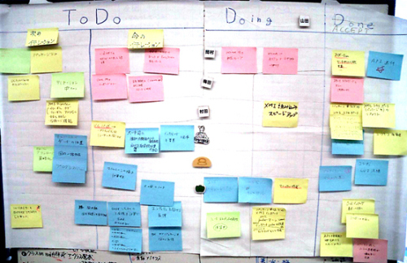
VISIBILITY
Notes:
It’s for the team!
As a project manager, you know that communication is quite important for the project. And I have never seen a better tool for communication than VISIBLE Dashboards.

Slide 37
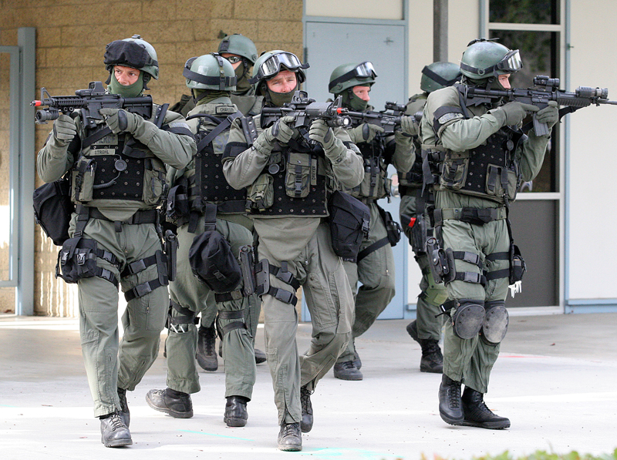
Developer
Analyst
Tester
Developer
Analyst
Tester
Developer
Analyst
Release Manager
Tester
Developer
Designer
Tester
Facilitator
CROSS-FUNCTIONAL TEAM
Notes:
Again, ONE team, ONE Goal. Different skills set

Slide 38

ENGINEER PRACTICES
Notes:
Design Patterns
Implementation Patterns
Clean Code
Refactoring
Test Driven Development
Technical Debit

Slide 39
“Doing good engineering is not primarily making good decisions, it's seeking good feedback which lets you quickly discard bad decisions”
Kent Beck

Slide 40
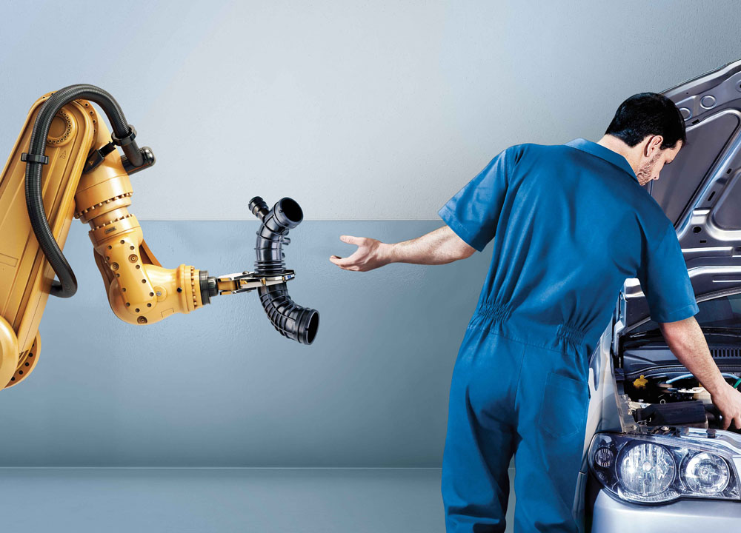
AUTOMATION
Notes:
Release + Tests

Slide 41

CONTINUOUS IMPROVEMENT
RETROSPECTIVES
Notes:
Team: QA, Development, Analysts , BA, Managers working together the achieve the business goals.
The team has voice is in constantly ways to improve the process based on the local reality and current problems.

Slide 42
SOME (OLD) STATISTICS

Slide 43
WASTE $€£
Standish Group Study
Reported by CEO Jim Johnson
XP2002
64% of code rarely used

Slide 44
WASTE $€£
2% of the code is used as written
$35BIlion , Department of Defense Software
Corsstalk Journal, 2002
< 5% of the code used
Commercial Software
400 projects over 15 years
IEEE conference 2001
Extracted from Jim Highsmith’s presentation: “Stop Doing Agile, Start Beging Agile”

Slide 45
Agile as Strategic Issue
“88% of executives cite organizational agility as key to global success”
“50% say that agility is not only important, but a core differentiator”
Source: The Economist, Special Report on Agility, March 2009
Extracted from Jim Highsmith’s presentation: “Stop Doing Agile, Start Beging Agile”

Slide 46
THE REALITY

Slide 47
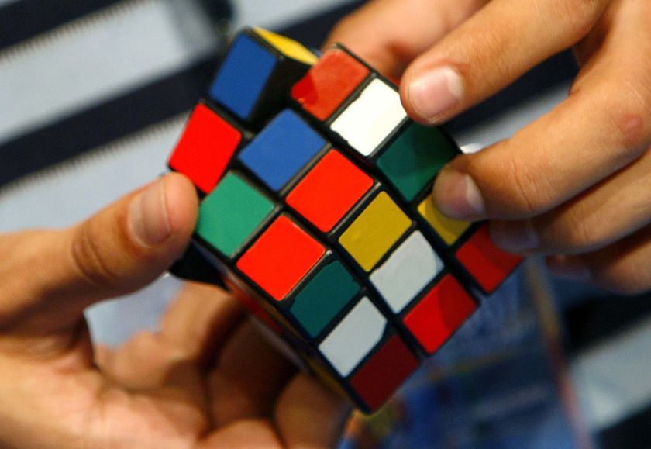
It is NOT EASY
Notes:
All of the Agile process are simple. Focus on principals and with few practices.

Slide 48

It requires NEW SKILLS
Notes:
Management skills
Analysis skills
Engineering skills

Slide 49

REQUIRES
PRACTISE
Notes:
If the global market needs companies able to work using Agile, we must have people prepared to do that. Regardless how much qualification Version 1 gives to the staff, only the practice will form people to use agile…

Slide 50

HOW TO START? PILOT PROJECT
Notes:
It’s common(and normal) managers and directors have FEAR of try a new thing, because it’s UNKNOWN. Start with an internal project or within a customer who is willing to try a different approach might be a good start.

Slide 51
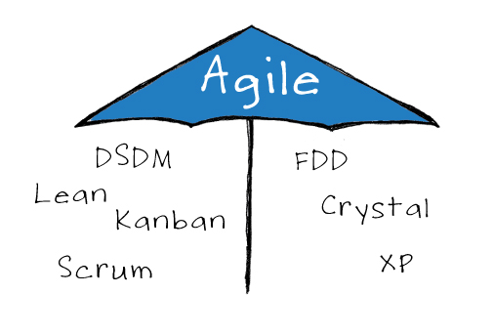
Agile it’s a tool set

Slide 52
HOW TO START
Focus on
Quality
feedback
Value Delivery
Short Iterations
Retrospectives
High level long plan
Low level short plan
Cross-functional team

Slide 53
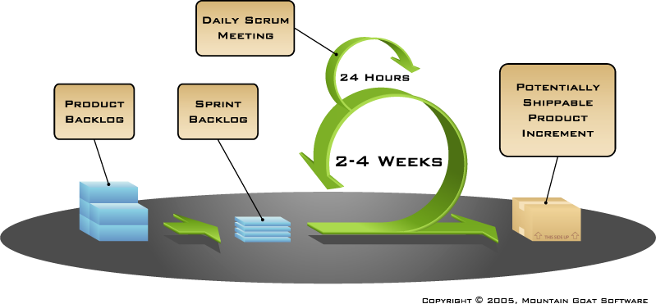
SCRUM – focus on management

Slide 54
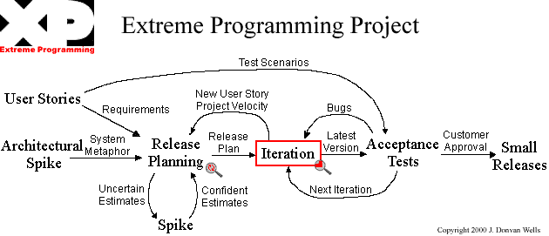
XP – focus on engineering practices

